Slide 1

The ETA Effect
March 2021 // Brian Larwig
Improving last mile operations and supply chain collaboration
with accuracy, visibility and transparency

Slide 2

Safe Harbor
The information presented is for informational purposes only and should not be relied upon in making a purchasing decision.
Trimble is under no legal obligation to deliver any future products, features or functions within any specified time frame, if at all.
Release dates and content are subject
to change at Trimble’s sole discretion. Information shared is confidential.
Safe Harbor
Notes:
"The information being presented is confidential, subject to change, and should not be used as a basis for making purchase decisions."

Slide 3
Trimble MAPS Mission & Vision
Transforming the way the world works with vehicles
Analytics
Commercial
Navigation
Developer
Tools
Driver Apps
Fleet Routing
& Scheduling
Mapping & Visualization
Delivery Time Window Optimization
Trip Management & ETA Alerting
Truck Routing
& Mileage
Connecting the physical and digital helping fleets
& drivers make better, smarter, safer decisions.
Notes:
Trimble MAPS is highly focused on connecting the physical and digital worlds
Our goal is to digitally simulate and optimize everything that could happen on a map
Routing, visualization, navigation, optimization, ETAs, mileage, places and more

Slide 4

Map Intelligence for the Entire Commercial Vehicle Routing Workflow
Resource & Route
Profitability Analysis
Driver Performance & Debriefing Fleet
Analysis Data Science
Distance & Duration
Strategic Planning & Network Modeling
Daily Routing & Decision Support
(Fleet & Vehicle Level)
Rooted in our global commercial vehicle map data and routing engine
Mobile Connectivity & Dispatch
Dynamic Resequencing
Navigation
Real-Time Visibility
Notes:
We are uniquely positioned to serve the entire commercial vehicle routing workflow from network modeling and strategic route planning to trip management and execution to real-time visibility and post-trip analysis.
Our map-centric solutions address both fleet-wide as well as vehicle-specific routing, scheduling, visualization and navigation needs and are built on a single source of rich commercial vehicle-specific road network data and route optimization engine.

Slide 5
Our Portfolio Includes:
A PLATFORM
INDIVIDUAL PRODUCTS
Mapping APIs
Routing APIs
Navigation APIs
Location APIs

Slide 6
Industry Trends and Expectations

Slide 7

Evolving Supply Chain Expectations
Better ETA’s are Vital to Success!
Full Transparency and Visibility
More Scheduling Variables than Ever
Automation
Increased customer expectations
Ever-increasing cost and efficiency pressure
Notes:
Full transparency and visibility have become a top priority for carriers, shippers, and anyone in the supply chain
More Variables: HOS, more complex freight networks
Fleets are looking to automate large portions of their logistics processes and relying on data analytics to drive efficiency into operations
Better doesnt just mean more accurate. Visibility, transparency, exception management and many more factors matter too
We will dive into much of this throughout the presentation

Slide 8

State of the industry: ETAs
ETAs are an integral part of keeping a transportation network running smoothly from end-to-end.
Regulatory mandates have had a dramatic effect on predicting arrivals
Shippers are under increasing pressure to deliver
Receivers are requiring tighter time windows
Notes:
Drive times and arrival times have been dramatically impacted by mandating driving hours and breaks
Shippers have implemented the practice of charging carriers penalties for missed deliveries
Delivery time windows are shrinking, increasing the need for advanced notice of arrival times

Slide 9
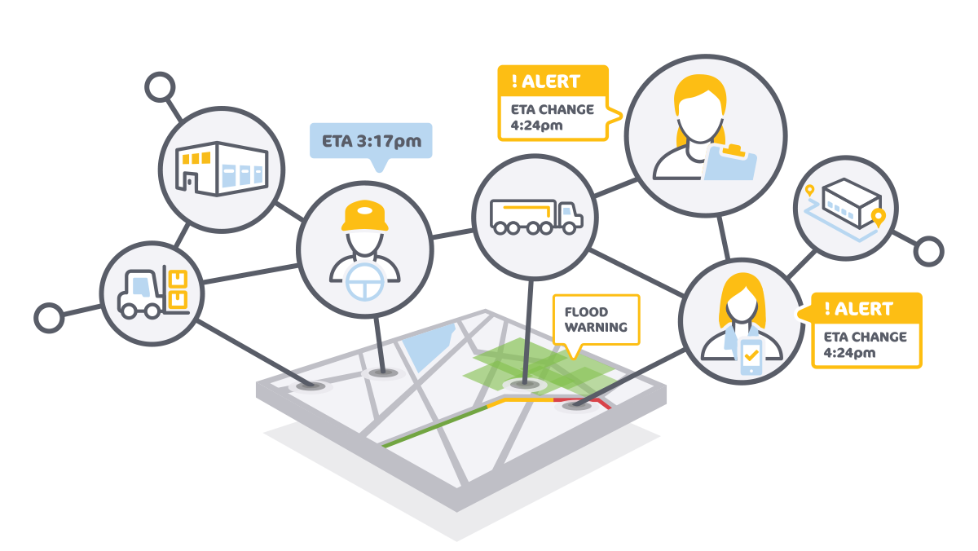
What Makes a Good ETA?
Early predictions
Account for as many variables
as possible
Real-time updating to account for
the changing world
Accounting for the waterfall effect
Transparency, Visibility, Communication, and Notifications
Notes:
Early predictions (anyone can predict an accurate ETA 5 minutes before arrival, what about 2 days before?)
Account for as many variables as possible
We are always studying deviation from the mean with ETAs and there are a host of expected and unexpected factors that lead to missed ETAs
Expected: HOS, weather, traffic, route deviations
Unexpected: Driver intent, societal factors (protests, etc), start time is one of the biggest (in the final mile, routes that start close to 8am miss more ETAs)
Real-time updating to account for the changing world
All those variables i mentioned, they never stop
Mechanisms have to exist to connect all these systems in real time or you lose a big part of the value
Accounting for the waterfall effect
I will get into this in more detail in the next section, but with how tight networks and routes are planned these days, one missed ETA causes a waterfall effect to the shipper, receiver, and the fleet
Transparency, Visibility, Communication, and Notifications
The most important part. The best ETA in the world doesnt matter if it cannot be communicated consistently.

Slide 10
The ETA Effect
Notes:
The name of the presentation. The ETA Effect itself. This section is all about the effect an ETA has on the broader ecosystem and how it impacts the effectiveness of a shipper, receiver, and carrier

Slide 11
ETA Effect: Carrier
42% of missed ETA’s lead to an additional missed ETA!
How a 10 minute delay can cascade to destroy an entire route.
Plan
1
2
3
4
10 Minute Delay
10 minutes late
40 minutes late
70 minutes late
10 Minute Delay
1
2
3
4
On-Time
Missed dock spot 20 minute delay
Traffic build up
10 minute delay
Full dock
30 minute delay
Notes:
Early is just as impactful as late.
All ETA misses aren’t equal. Missing an ETA by 5 minutes on a 1000 mile trip is quite different than missing by 5 minutes on a 1 mile trip.
We have complex definitions for what a “miss” is.

Slide 12
ETA Effect: Receiver
There was an accident.
I will be 20 minutes late to the site.
This impacts our delivery time window and next load
pickup time.
I’ll need to have receiving stay
late tonight.
We’ll need to charge them a late fee, and
pay our employees overtime.
Notes:
“If the shipper is looking at different data points, different ETAs, they can have people set up to unload the trailer on the dock, and they won’t
be there at the right time. From having people sitting idle to not having the truck ready for the next move, all that has negative cascading effects throughout the ecosystem.”
If an expected load is late or delayed, a receiver’s distribution center will either have to send employees home early or have them stay late
If a driver arrives before an appointment time, that can result in detention time, while missing a delivery window can result in a layover to the next day. For large customers that have little-to-no leeway in accepting unplanned deliveries, the delay could be even longer.

Slide 13
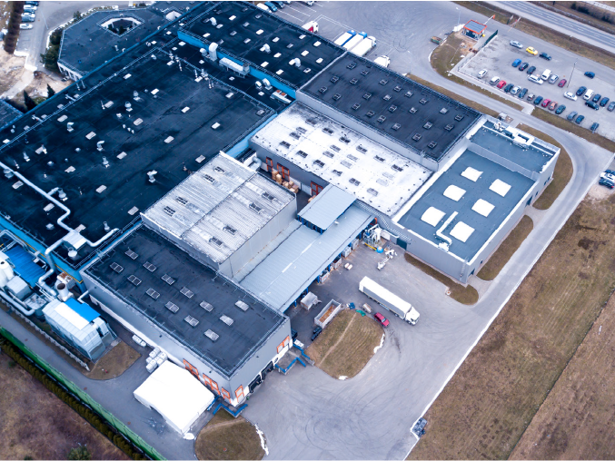
ETA Effect: Shipper
Shipper may have to pay late fees or refund
ETA accuracy is reflection on the customer service
of the shipper
Customer expectation on shipper visibility is
continually growing
60% of consumers who have a “bad shipping experience” will consider shopping somewhere else next time
71% of consumers who experience a shipping delay will rate a higher satisfaction score on post-purchase surveys if they were notified about the delay ahead of time
55% of consumers will stop shopping with a retailer after 2-3 late deliveries
ETA
PM
Notes:
https://www.supplychainbrain.com/articles/14912-impact-of-late-or-inaccurate-deliveries-can-be-disastrous-study-shows

Slide 14
ETA Workbench
The Tools of the Trade

Slide 15
What Tools Are Needed for the Best Possible ETAs?
Strong network design and modeling tools
Shipper-Carrier collaboration tools
Advanced route planning tools
Commercial Mapping and Location solutions
Connected data ecosystem
Visibility and Alerting Tools
Notes:
Strong network design and modeling tools to give you a baseline of a reliable, repeatable network
Shipper-Carrier collaboration tools to effectively communicate a good understanding of expectations
Advanced route planning tools
Our research shows a strong correlation between standard optimization metrics (mileage reduction, out of route mileage reduction, etc) and ETA accuracy
Commercial Mapping and Location solutions
Connected data ecosystem - Have to account for variables that are tracked in a variety of systems
Visibility and Alerting Tools to ensure compliance and manage exceptions

Slide 16
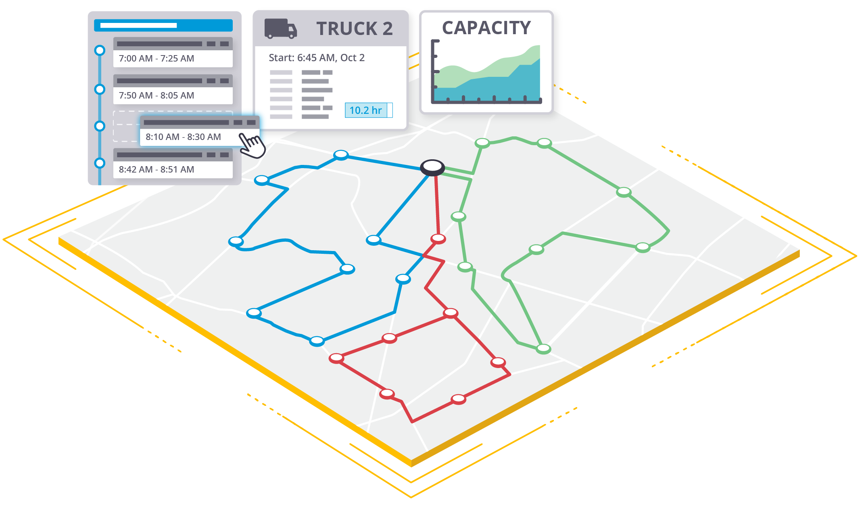
Network Modeling and Route Optimization
Notes:
Strong network design and optimization tools (#1 and #3 from the tools slide)

Slide 17

We’re building a framework for carrier-shipper collaboration through location sharing to increase efficiency and reduce friction
Trip Management & ETA Alerting
Shippers
Carriers
Rich Commercial Location Data
Drivers
Mapping & Routing
Notes:
Shipper - Carrier Collaboration

Slide 18

Commercial map intelligence helps everyone adapt to unexpected events
You can plan precisely, but you can’t always control what happens on the road!
ETA
PM
ETA
PM
Notes:
Commercial Map Data

Slide 19
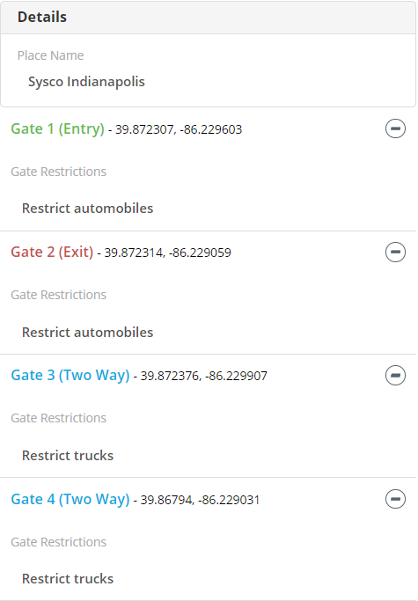
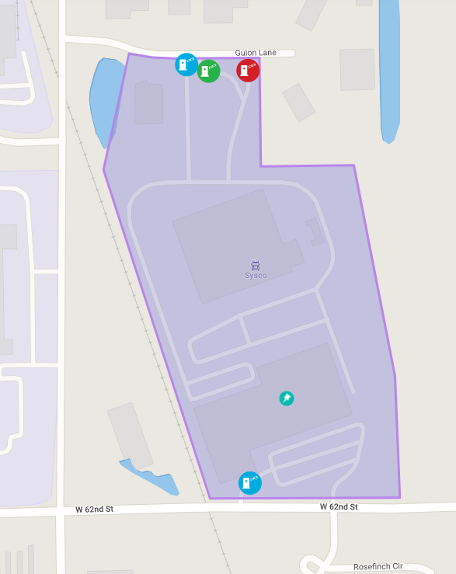
Commercial vehicles need commercial location data.
Truck restricted
>25% of locations are off by more than 0.5 miles
Zip code alone can be off by more than 20 miles
Truck entrances and exits are different than auto (This has a direct impact on safe navigation)
Truck restricted
Notes:
Commercial Map and Location Data

Slide 20
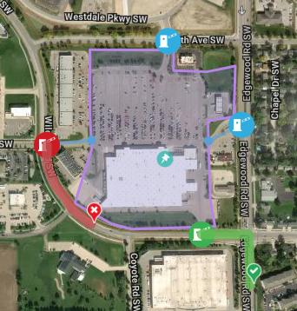
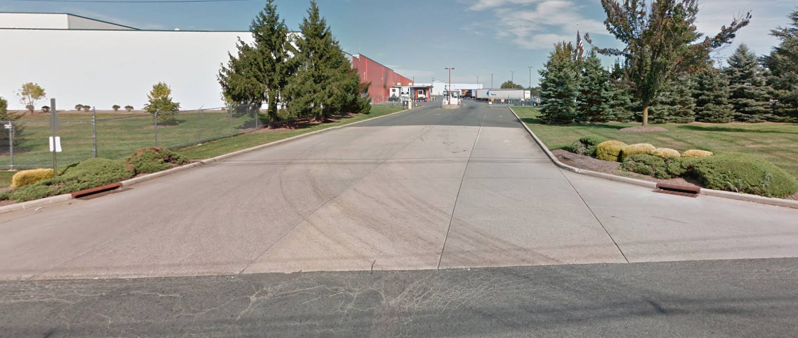
We’ve verified and predefined a collection of commercial Places with rich facilities data for last mile routing and navigation
Product Co. Warehouse
Precise Location
Site Boundary (Geofence)
Entry Gate and Preferred Path
Exit Gate and Preferred Path
6201 Warehouse Rd.
Flemington, NJ 08822
Hours of Operation
Mon | 6a-4p
Tue | 6a-4p
Wed | 6a-4p
Thu | 6a-4p
Fri | 6a-4p
Sat | 9a-2p
Sun | Closed
Actionable Attributes
Contact Number
609-555-1212
Avg. Dwell Time (min.)
65
X
Overnight Parking
More
Notes:
Commercial map and location data
Actionable attributes:
Hours of operation
Contact details
Parking rules and availability
Driver-accessible amenities including food, restrooms
Site policies and rules
Driver notes and alerts

Slide 21


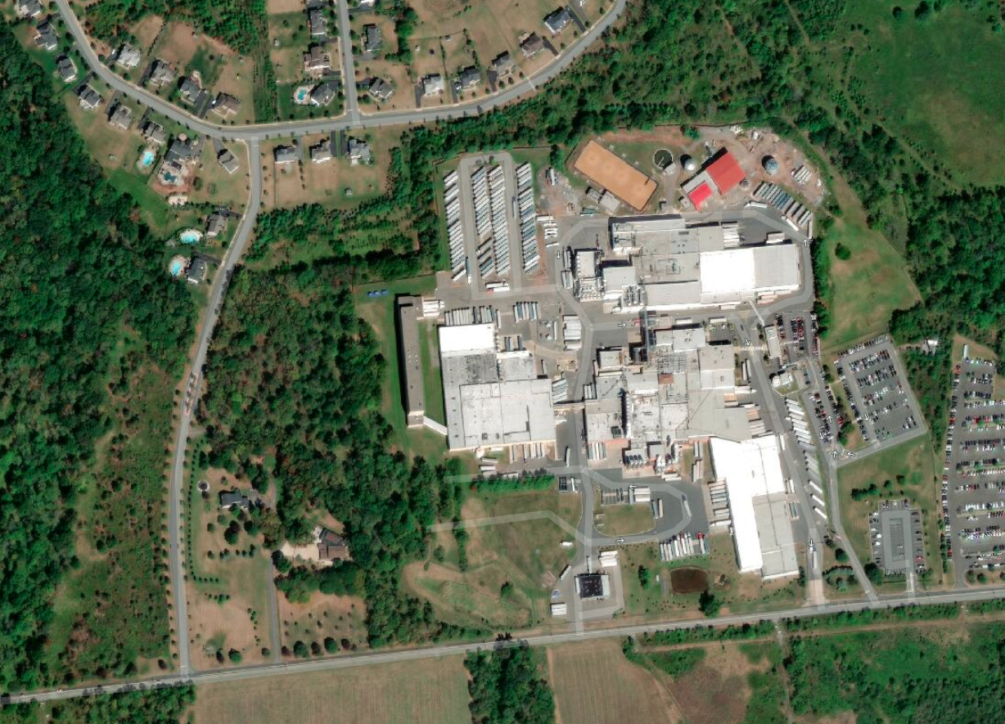
Connecting the transportation ecosystem with ETA data sharing
TRUCK ARRIVAL
Gate 4
8/22/20 | 3:47 AM
ROADWAY INCIDENT
Driver hits traffic
& takes alternate route
HOS BREAK CHANGE
Driver decides to
take a longer break
PLAN
8/21/20
7:01 PM
ETA
8/21/20
7:28 PM
ETA
8/22/20
3:45 AM
Shipper
Warehouse
DRIVER
“I’m not going to make the pickup in time
before they close.”
DISPATCHER
“Okay, I’ll inform
the shipper and reschedule the pickup.”
SHIPPER
“Let’s reschedule pickup for tomorrow morning.”
Notes:
Connected data ecosystem
Alerts:
Out-of-route and out-of-corridor events
HOS break time changes
Traffic and weather conditions
ETA updates
Arrival status changes
Benefits
Make informed, proactive decisions
Get ahead of service failures
Reduce dispatch calls to driver
Data-driven future load planning
Improve asset utilization
Build better relationships

Slide 22
Using precise location data in the last mile for accurate ETAs and driver safety
A Use Case with one of the top 100 largest trucking companies in the U.S.

Slide 23

The Challenge
I wonder
if parking is available at the facility
“Turn on 3rd Street.”
But the customer says:
“Turn on 5th Street!”
Last mile guidance for drivers using safe, legal roads
Accurate ETA prediction with last mile variables
Difference in street address and actual
truck entrance at facility
Incorporating customer-provided directions
to drivers into navigation
Sending important delivery/pick up notes
to drivers
Notes:
Across the trucking industry, last-mile routing—or the final leg of a journey from a transportation hub to the destination—remains a major hurdle because of the gap between navigation systems which focus on major roadways and the multiple options to enter final destination locations. It is common for a driver to attempt to deliver a load and navigate local streets, only to find that a local ordinance restricts certain types of truck through-travel or street corners with obstacles that prevent safe turns.

Slide 24
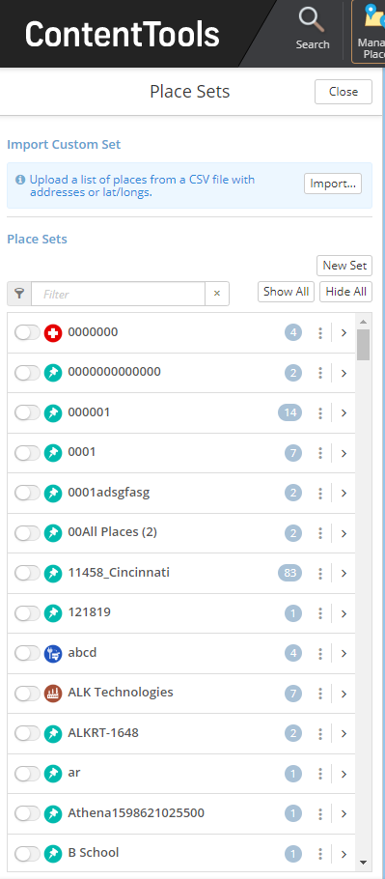
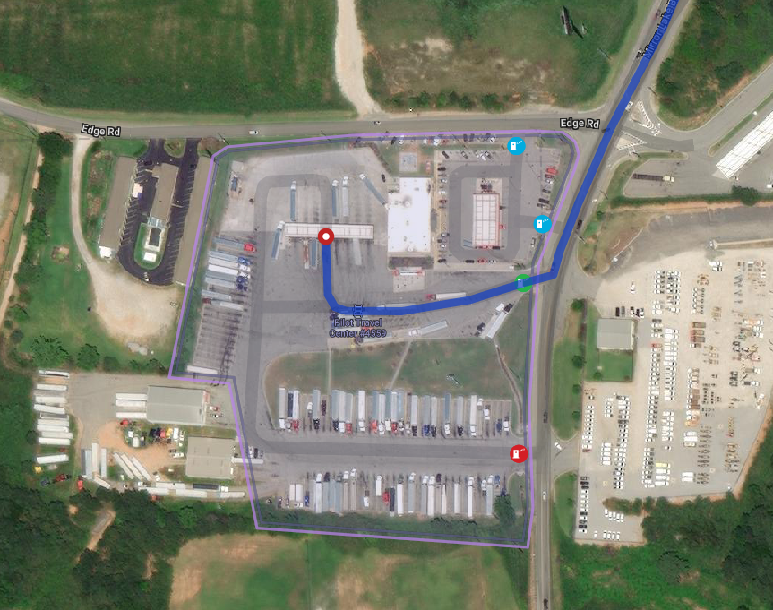
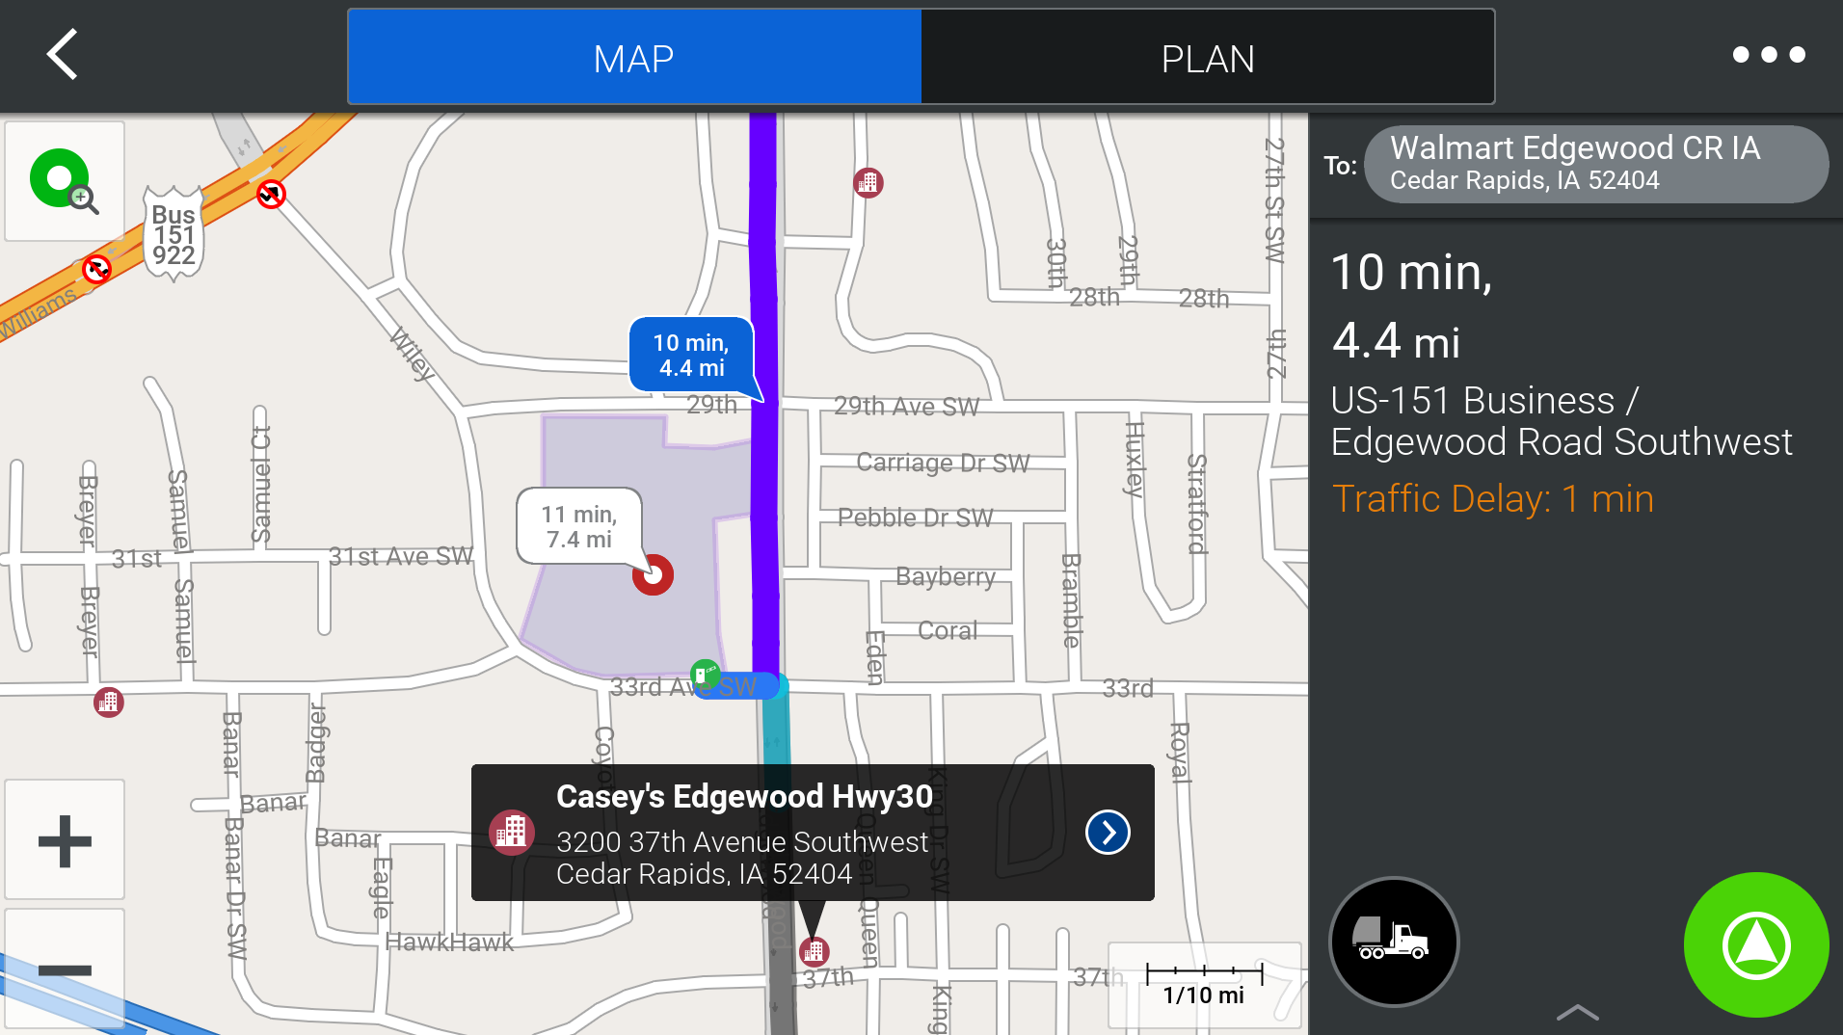
The Solutions
Predefined customer locations with boundary polygons, truck entrance and exit gates, and paths that outline the customer’s recommended routes
Added specific driver guidance messages
Data delivered directly to in cab navigation
for drivers
More precise ETAs information sent directly to back office
Driver navigates directly to site based on location specific details

Slide 25

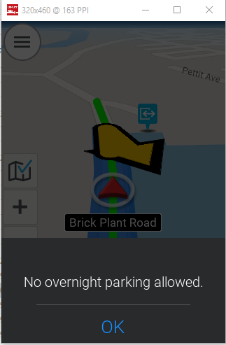
The Results
Better dispatch visibility into ETAs
Improved future load planning
Precise last mile routing and navigation
in the last mile
Drivers feel safe and confident
Improved driving experience
Drivers often request last mile route integration if it is a location that has not yet been updated!
Notes:
Drivers will often request last mile route integration before leaving if it is a site that has not yet been updated!

Slide 26
maps.trimble.com
Commercial
Navigation
Developer
Tools
Mapping & Visualization
Analytics
Truck Routing
& Mileage
Fleet Routing
& Scheduling
Delivery Time Window
Optimization
Trip Management & ETA Alerting
Driver Apps
Notes:
Mention platform, mention how we help with this journey. Come talk to us, it is our mission to get you better ETAs

Slide 27
Brian Larwig
Strategy & Operations
brian_larwig@trimble.com
Notes:
Q&A will be done live once presentation is over

